Slide 1
Performance Evaluation and Applications
Project A
Recharging of an electric car on a highway
2023-2024
Angelo Maximilian Tulbure
10931652
1

Slide 2
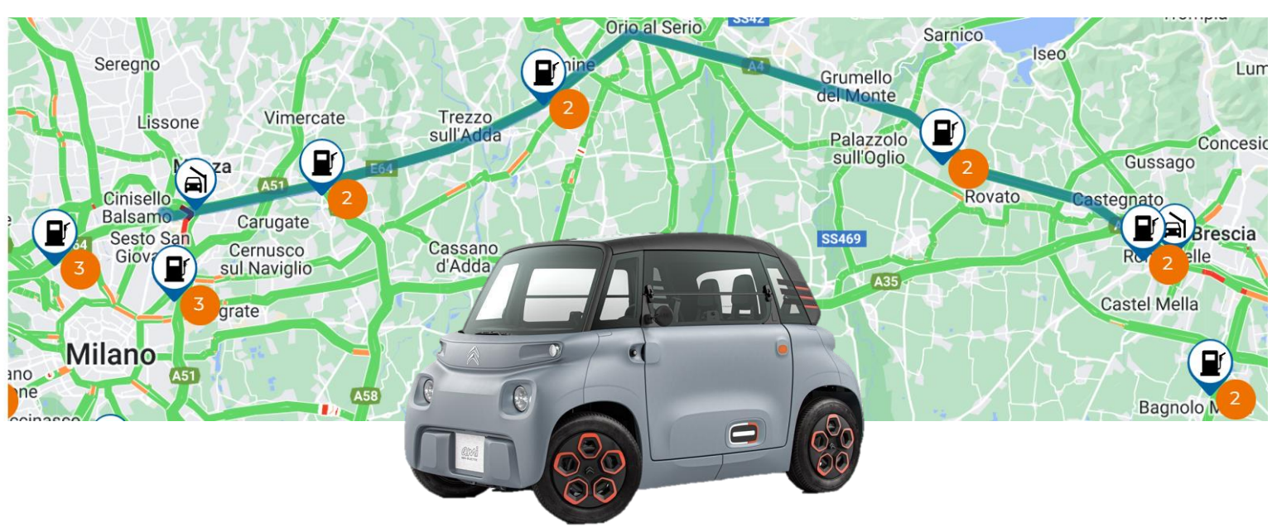

Project A - Recharging of an electric car on a highway
Problem description:
• An electric car has to travel a distance which is slightly longer than the one allowed by its
battery capacity: it must stop exactly once for recharging on the way!
• There are four road segments on the route, with three charging stations in between: each station has a number of chargers available, and a different loads in number of requests.
• Considering a given probability of choosing exactly one of the charging station, compute
the average total travelling time.
2
Angelo Maximilian Tulbure - 10931652

Slide 3
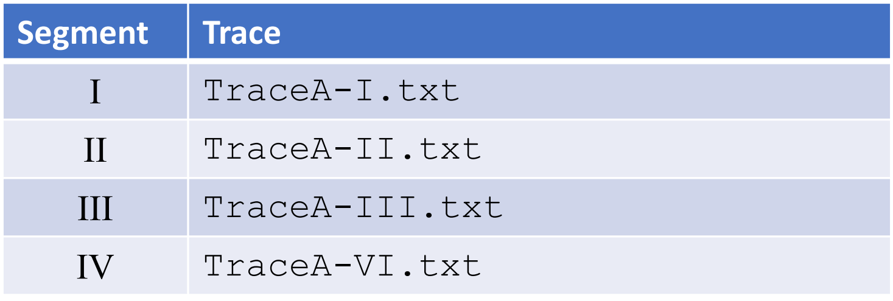
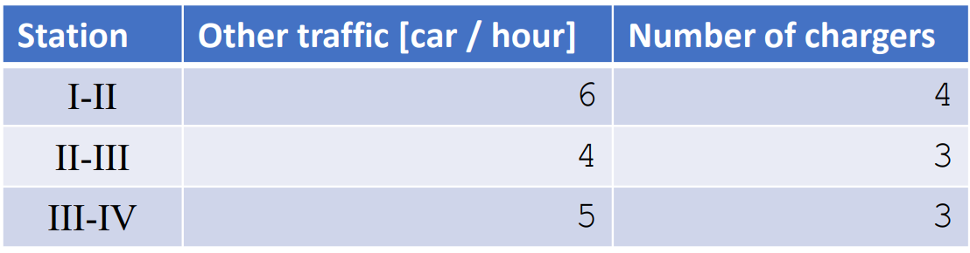

Project A - Recharging of an electric car on a highway
The travelling times of the four segments, is distributed according to the following traces [all times are expressed in minutes]:
• Charging time are exponentially distributed, according to an exponential distribution, with an average of 30 minutes.
• The request rate by other cars at the station, and the number of chargers, is given in the following table.
• A station is identified by the number of the segments it is between.
3
Angelo Maximilian Tulbure - 10931652

Slide 4

Project A - Recharging of an electric car on a highway
• Determine the best stopping probability distribution: test a few alternatives of probabilities of stopping at each station, and for each scenario determine the average travelling time.
• Hint: the motion of the car can be considered as a closed system, with a single job, where the car once it has completed its course, it is teleported back to the initial position to immediately start another trip.
• Other cars competing for the charger, can be seen as an open process.
My Approach:
Initially, I attempted to model this issue by experimenting with various distributions for each trace using Matlab, aiming to identify the ones that best matched the samples.
To obtain the most precise result I tested 6 different distributions: Uniform, Exponential, Erlang, Hypo Exponential, Weibull and Pareto (Hyper Exponential couldn’t be used because the CoV of all the traces was < 1).
4
Angelo Maximilian Tulbure - 10931652

Slide 5
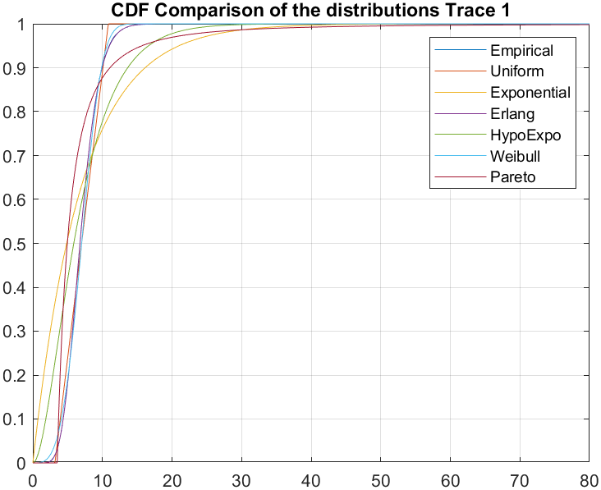


Project A - Recharging of an electric car on a highway
Parameters of the distributions in Trace 1:
Uniform:
a = 3.174544069688094
b = 10.844969751111904
Exponential:
lambda = 0.142658299393572
Erlang:
k = 10
lambda = 1.426582993935715
Hypo Exponential:
lambda 1 = 0.285317013770477
lambda 2 = 0.285316189105212
Weibull:
k = 3.507051598714520
lambda = 7.789975586826717
Pareto:
m = 3.504878421145154
alpha = 2.00020010001112
5
Angelo Maximilian Tulbure - 10931652

Slide 6
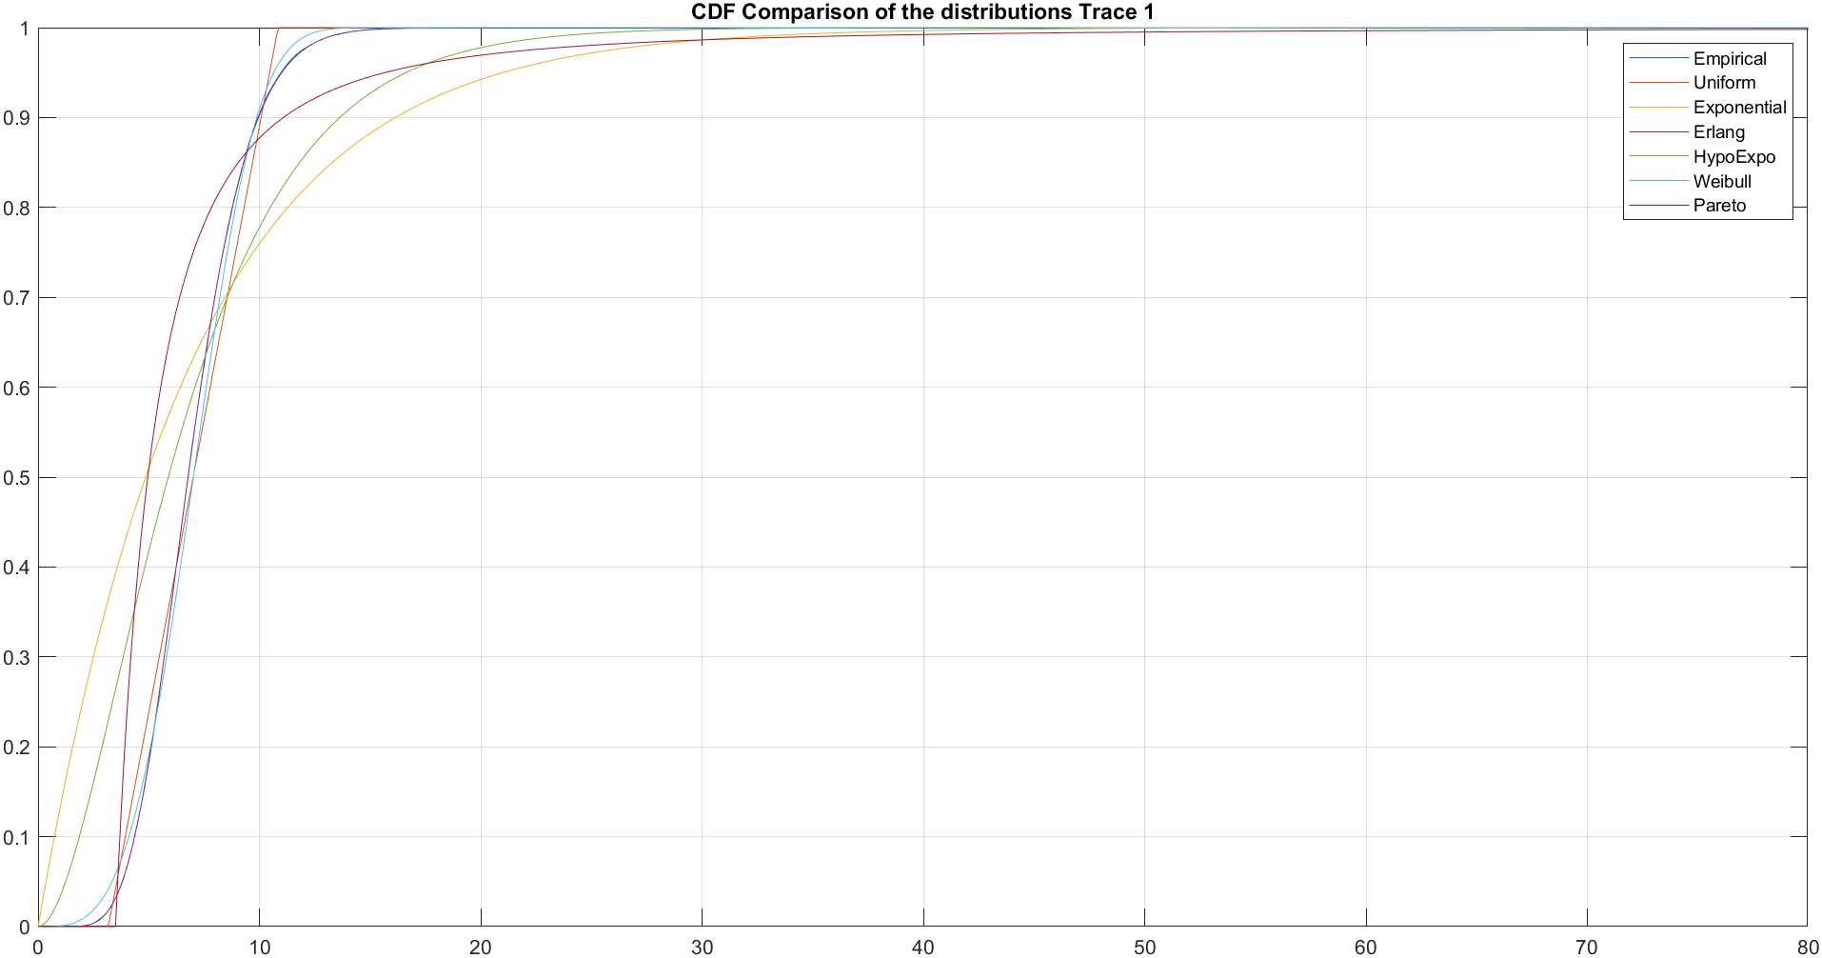


Project A - Recharging of an electric car on a highway
Parameters of the distributions in Trace 1:
6
Angelo Maximilian Tulbure - 10931652

Slide 7
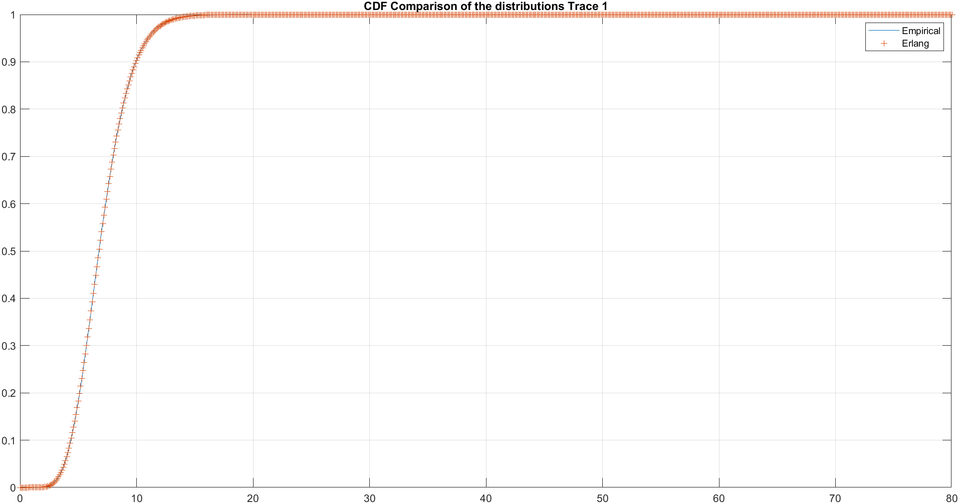
Project A - Recharging of an electric car on a highway
Parameters of the distributions in Trace 1:
Taking a closer look at the empirical and Erlang, we can see that the Erlang distribution fits the best the samples of Trace 1.
Parameters of Erlang:
k = 10
lambda = 1.426582993935715
7
Angelo Maximilian Tulbure - 10931652

Slide 8
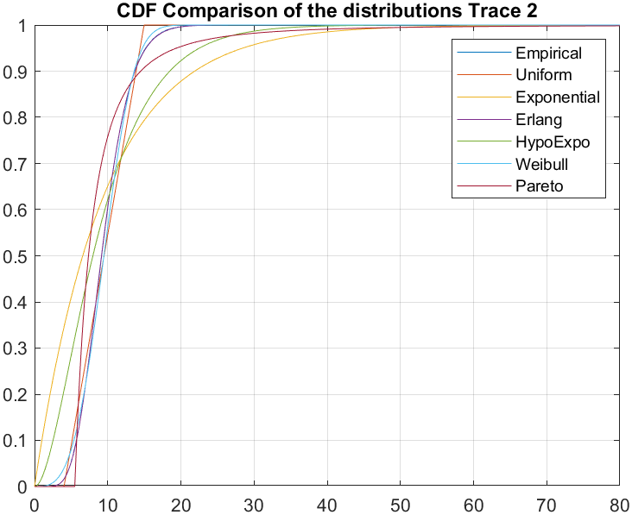
Project A - Recharging of an electric car on a highway
Parameters of the distributions in Trace 2:
Uniform:
a = 4.032817066619868
b = 14.972156553780168
Exponential:
lambda = 0.105235610422168
Erlang:
k = 9
lambda = 0.947120493799513
Hypo Exponential:
lambda 1 = 0.210471526967602
lambda 2 = 0.210470918631789
Weibull:
k : 3.504878421145154
lambda : 10.591088205750287
Pareto:
m : 5.507498933340573
alpha : 2.378602164287453
8
Angelo Maximilian Tulbure - 10931652

Slide 9
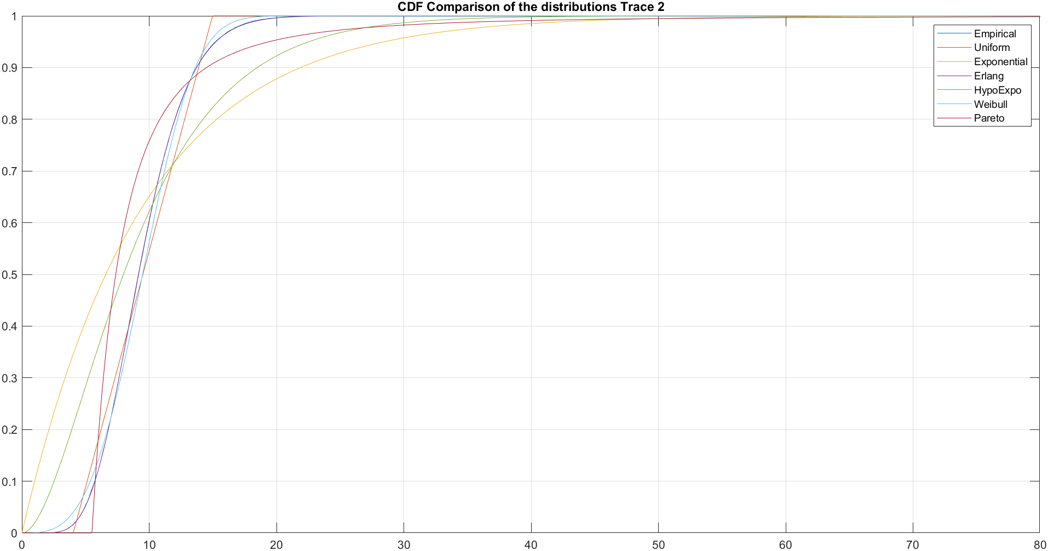

Project A - Recharging of an electric car on a highway
Parameters of the distributions in Trace 2:
9
Angelo Maximilian Tulbure - 10931652

Slide 10
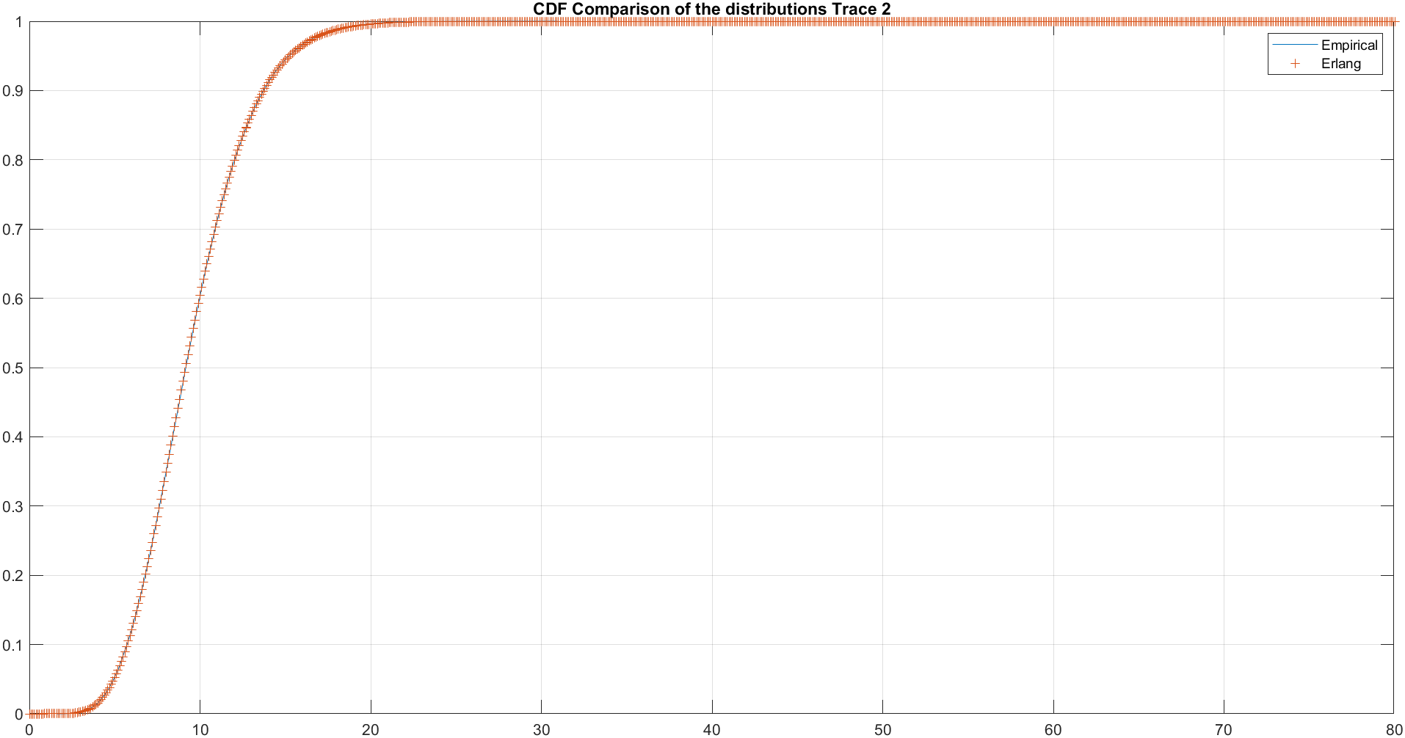
Project A - Recharging of an electric car on a highway
Parameters of the distributions in Trace 2:
Taking a closer look at the empirical and Erlang, we can see that the Erlang distribution fits the best the samples of Trace 2.
Parameters of Erlang:
k = 9
lambda = 0.947120493799513
10
Angelo Maximilian Tulbure - 10931652

Slide 11
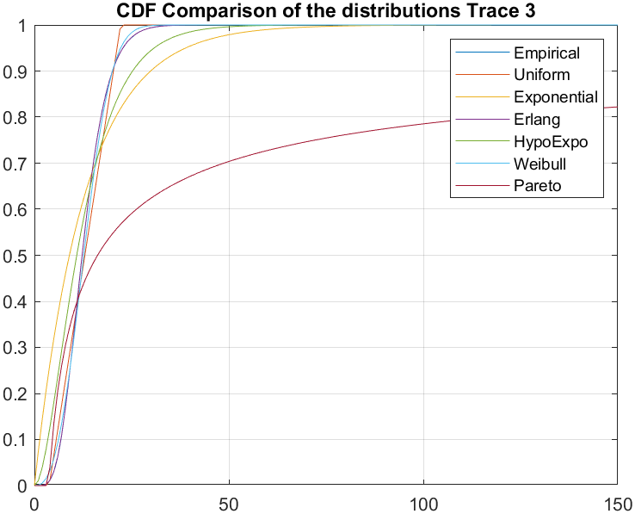
Project A - Recharging of an electric car on a highway
Parameters of the distributions in Trace 3 :
Uniform:
a = 3.782077358611238
b = 22.163063272988815
Exponential:
lambda = 0.077085725932204
Erlang:
k = 6
lambda = 0.462514355593221
Hypo Exponential:
lambda 1 = 0.154171170038689
lambda 2 = 0.154171721828660
Weibull:
k : 2.629223203983130
lambda : 14.600326085310133
Pareto:
m : 3.656429909416514
alpha : 0.464976022060314
(For the Pareto case, we have an infinite mean because alpha is < 1 and infinite variance. For this reason it’s the least appropiate distribution for trace 3).
11
Angelo Maximilian Tulbure - 10931652

Slide 12
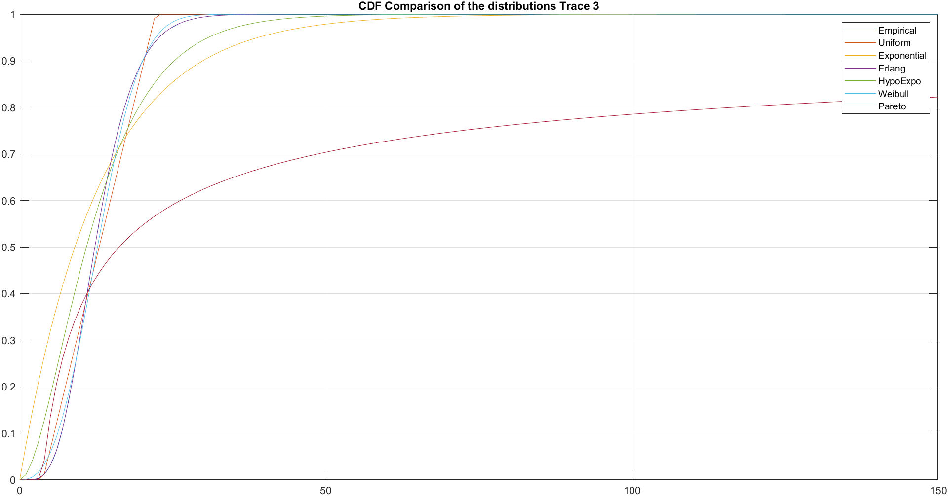
Project A - Recharging of an electric car on a highway
Parameters of the distributions in Trace 3:
12
Angelo Maximilian Tulbure - 10931652

Slide 13
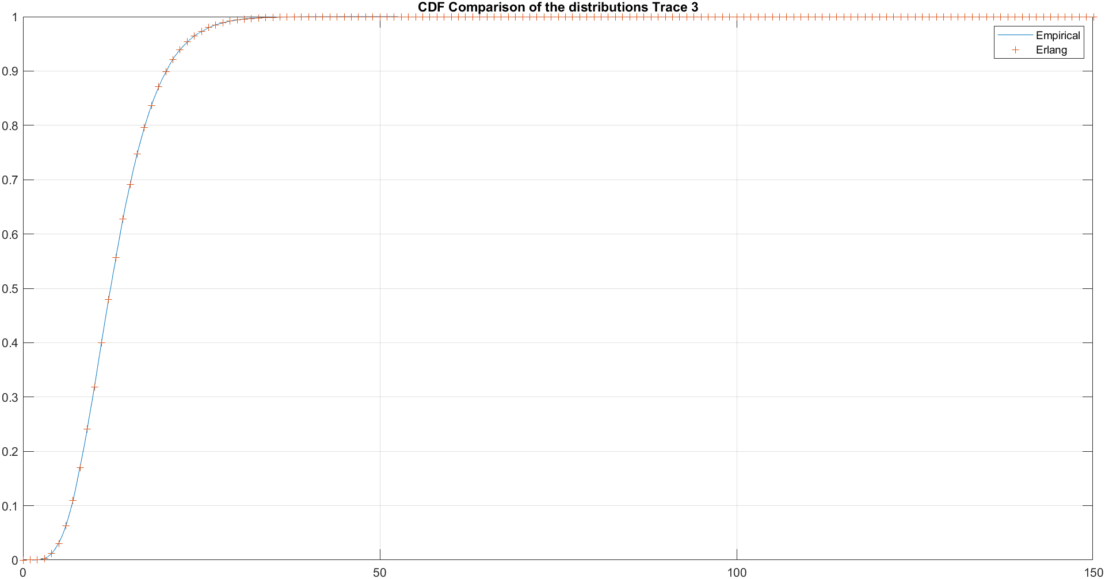
Project A - Recharging of an electric car on a highway
Parameters of the distributions in Trace 3:
Taking a closer look at the empirical and Erlang, we can see that the Erlang distribution fits the best the samples of Trace 3.
Parameters of Erlang:
k = 6
lambda = 0.462514355593221
13
Angelo Maximilian Tulbure - 10931652

Slide 14
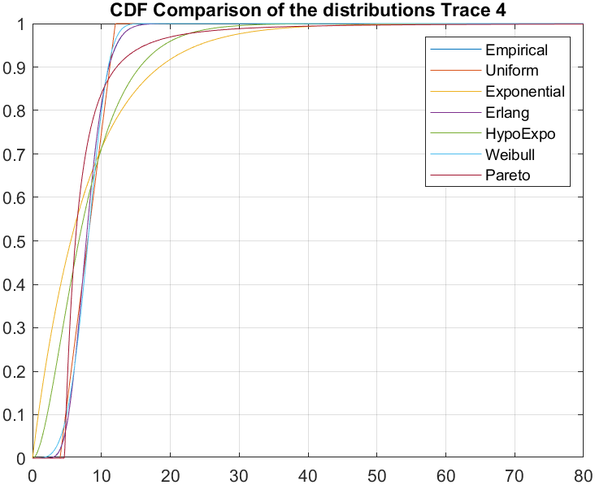
Project A - Recharging of an electric car on a highway
Parameters of the distributions in Trace 4:
Uniform:
a = 3.997730225316182
b = 12.024779903083825
Exponential:
lambda = 0.124824386689261
Erlang:
k = 12
lambda = 1.497892640271129
Hypo Exponential:
lambda 1 = 0.249649233800353
lambda 2 = 0.249648644068338
Weibull:
k : 3.867052192203060
lambda : 8.855423793450832
Pareto:
m = 4.654559759681054
alpha = 2.386649468426394
14
Angelo Maximilian Tulbure - 10931652

Slide 15
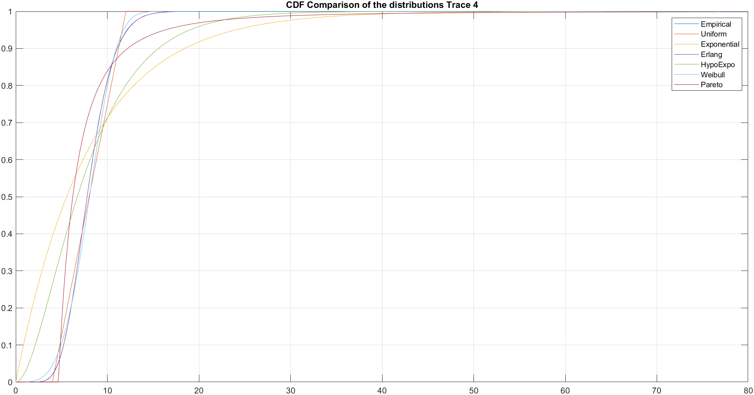
Project A - Recharging of an electric car on a highway
Parameters of the distributions in Trace 4:
15
Angelo Maximilian Tulbure - 10931652

Slide 16
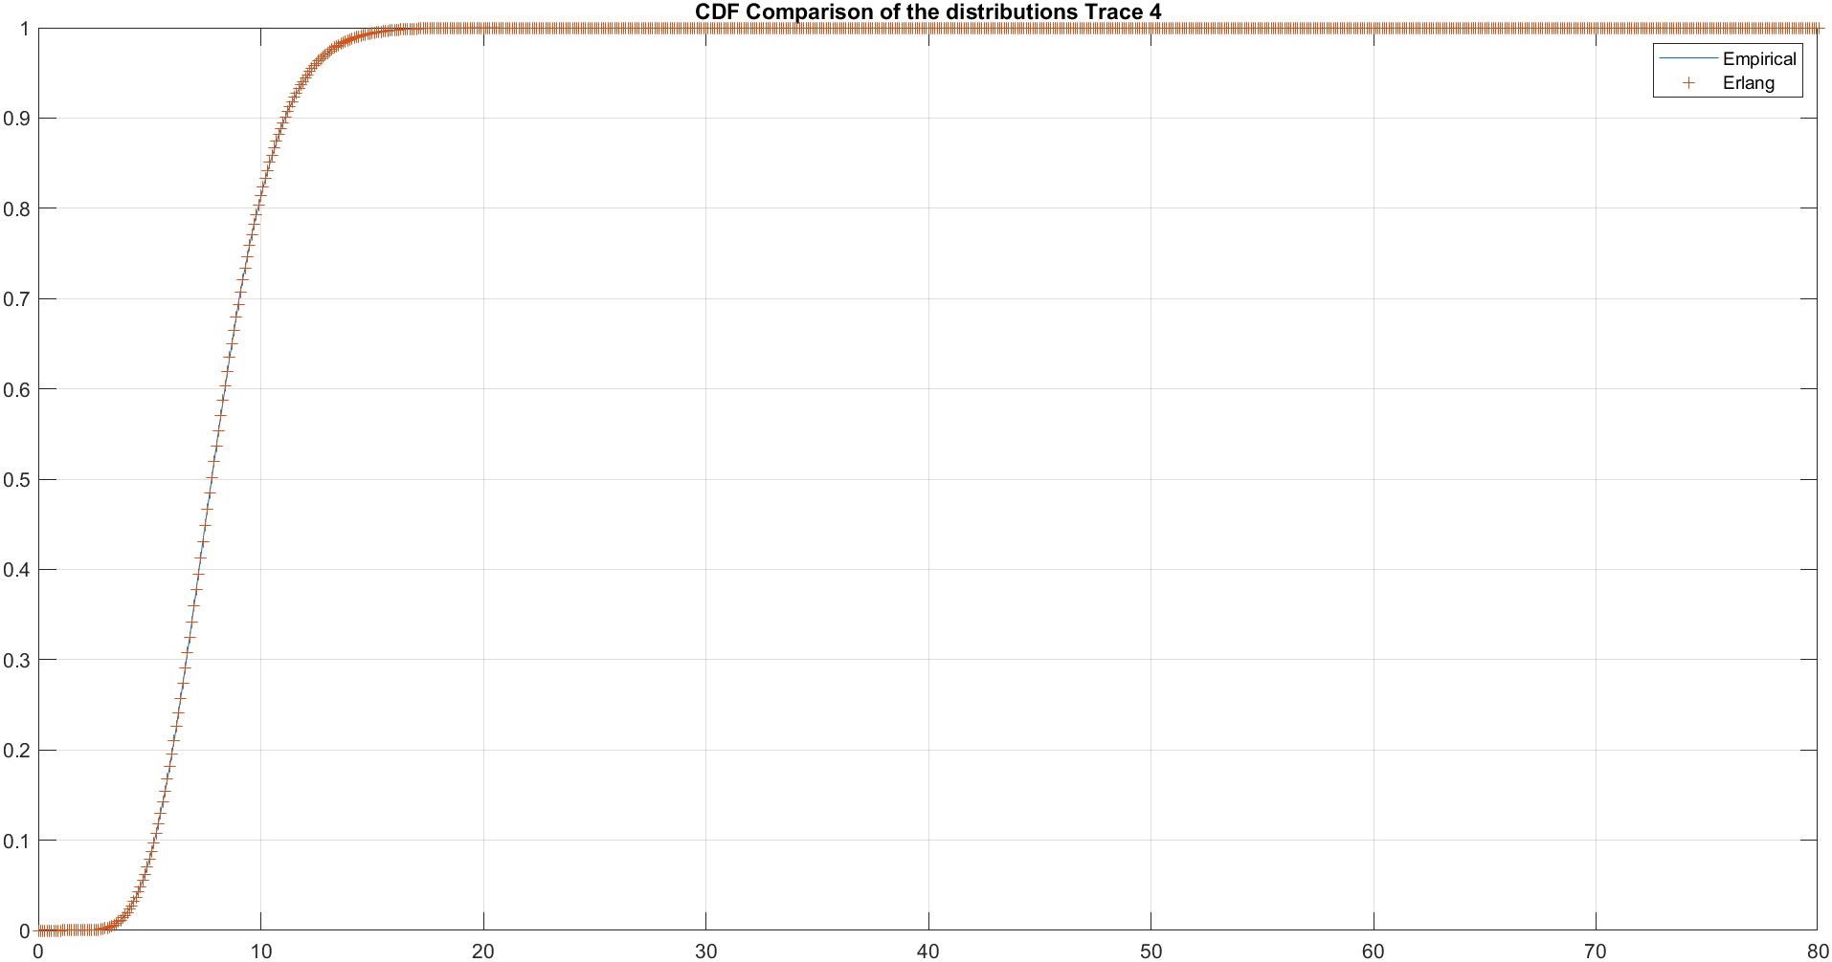
Project A - Recharging of an electric car on a highway
Parameters of the distributions in Trace 4:
Taking a closer look at the empirical and Erlang, we can see that the Erlang distribution fits the best the samples of Trace 4.
Parameters of Erlang:
k = 12
lambda = 1.497892640271129
16
Angelo Maximilian Tulbure - 10931652

Slide 17
Project A - Recharging of an electric car on a highway
To sum up, the distributions that fitted the best the samples of the different traces are:
o Trace 1 → Erlang with: k = 10, lambda = 1.426582993935715
o Trace 2 → Erlang with: k = 9, lambda = 0.947120493799513
o Trace 3 → Erlang with: k = 6, lambda = 0.462514355593221
o Trace 4 → Erlang with: k = 12, lambda = 1.497892640271129
17
Angelo Maximilian Tulbure - 10931652

Slide 18
Project A - Recharging of an electric car on a highway
Next, my approach shifted to modeling this problem as a Queuing Network, employing queuing stations.
I considered the motion of the electric car as a closed system, with a single job, where the car once it has completed its course, it is teleported back to the initial position to immediately start another trip.
I considered the other cars competing for the charger as an open process.
To visualize and design this model graphically, I utilized a tool within JMT (Java Modelling Tool), specifically JSimGraph.
18
Angelo Maximilian Tulbure - 10931652

Slide 19
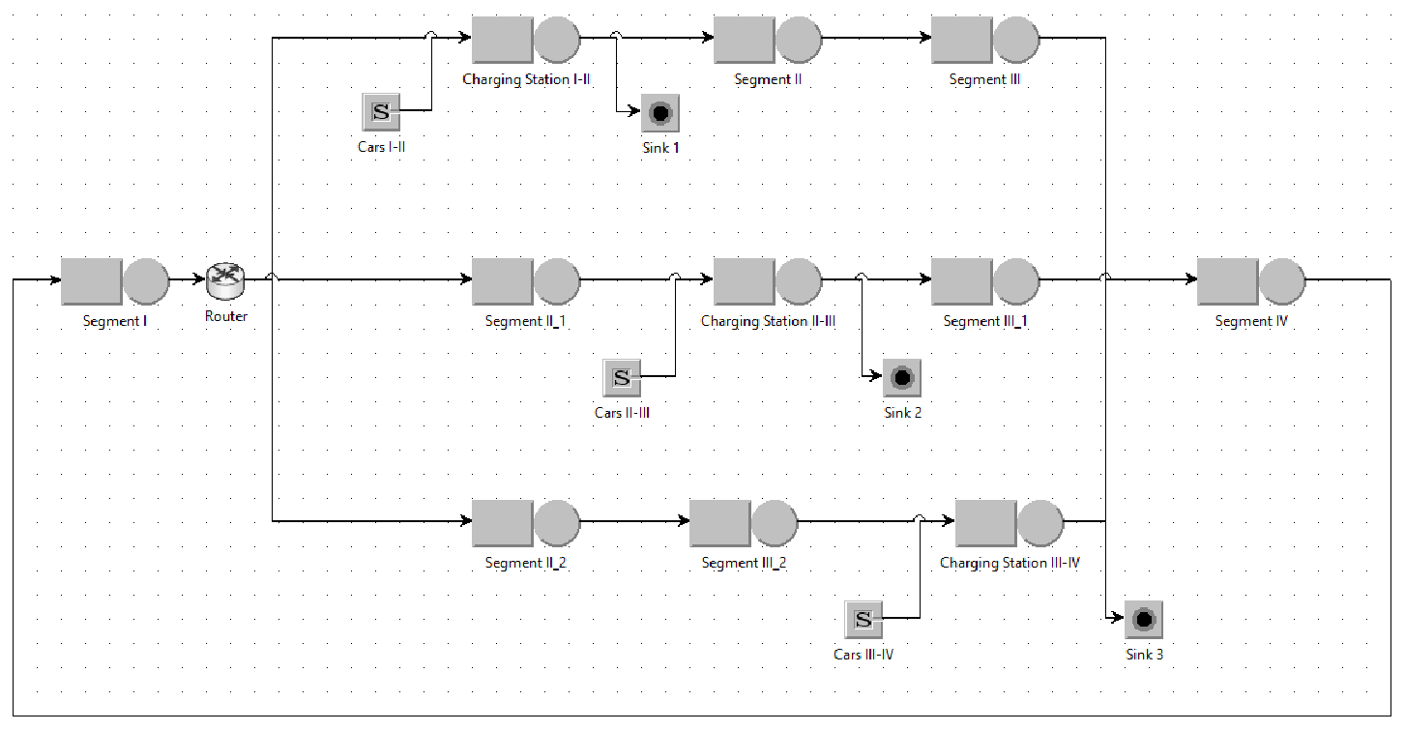
Project A - Recharging of an electric car on a highway
The model of the problem on JSimGraph is the following:
19
Angelo Maximilian Tulbure - 10931652

Slide 20
Project A - Recharging of an electric car on a highway
We have 3 possible paths:
- In the first path, the electric car is stopping to recharge in the charging station between Segmet I and II. Then it’s continuing its trip until it reaches the destination point.
- In the second path, the electric car is going through the first 2 segments of the highway and it’s stopping to charge in the station between Segment II and III. Then it’s continuing its trip until it reaches the destination point.
-In the third path, the electric car is going through the first 3 segments of the highway and it’s stopping to charge in the station between Segment III and IV. Then it’s going through the last segment (Segment IV) and it reaches its destination.
By having a router after Segment I, we can test different probabilities of stopping at each station, and for each scenario we can determine the average travelling time, in order to determine the best stopping probability distribution.
20
Angelo Maximilian Tulbure - 10931652

Slide 21
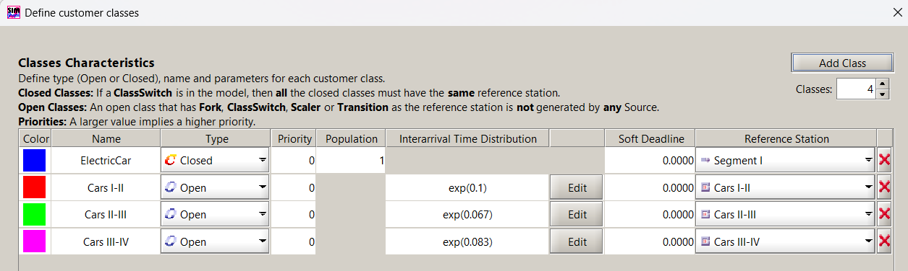
Project A - Recharging of an electric car on a highway
I considered the motion of the car as a closed system, with a single job, and the other cars competing for the process as 3 open models, one for each charging station.
The Interarrival Time Distributions of the other traffic cars are:
lambda = 6/60 = 0,1 cars/minute (for the first charging station)
lambda = 4/60 = 0,067 cars/minute (for the second charging station)
lambda = 5/60 = 0,0833 cars/minute (for the third charging station)
21
Angelo Maximilian Tulbure - 10931652

Slide 22
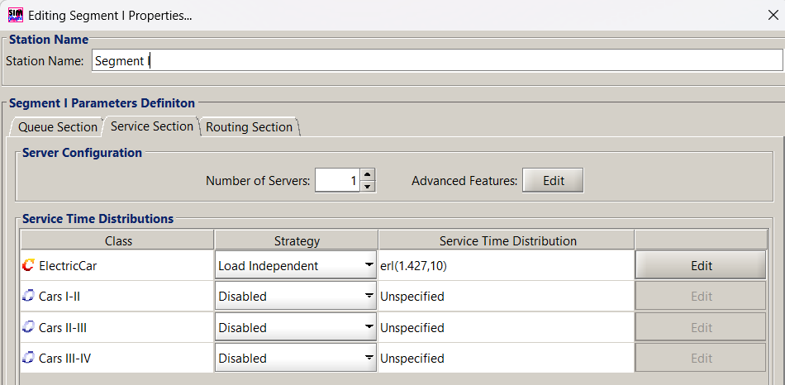
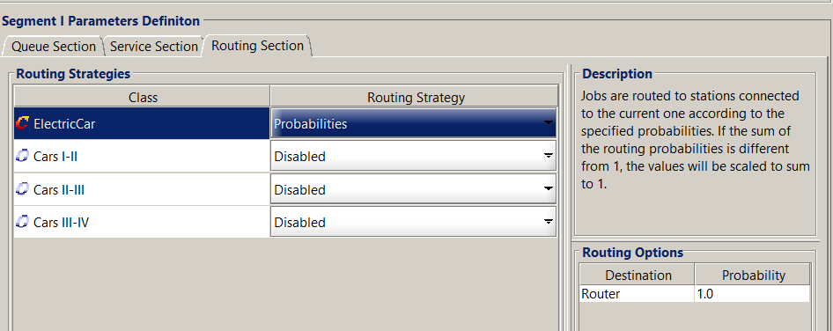
Project A - Recharging of an electric car on a highway
Segment I :
The parameter used for the Service Time Distribution are the ones found in Matlab doing the fitting.
The Routing sections of all the queues were used with probability = 1 for the electric car.
22
Angelo Maximilian Tulbure - 10931652

Slide 23
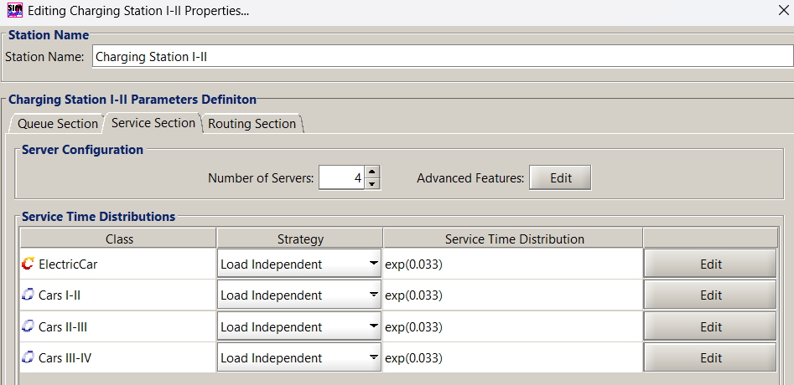
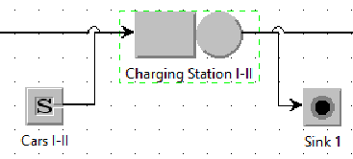
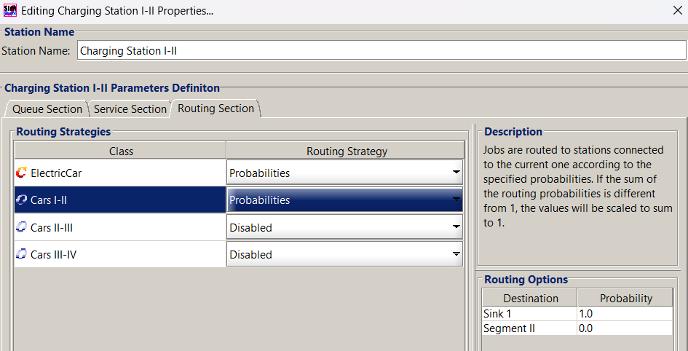
Project A - Recharging of an electric car on a highway
Charging Station I-II :
The parameter used for the Service Time Distribution are exponential with mean = 30 minutes (the average charging time of a car).
As there are 4 chargers in the station, I set the Number of Servers equal to 4.
I generated the traffic of the other cars from a source and I directed all to a sink after the charging station (probability to go to the sink1 = 1).
23
Angelo Maximilian Tulbure - 10931652

Slide 24
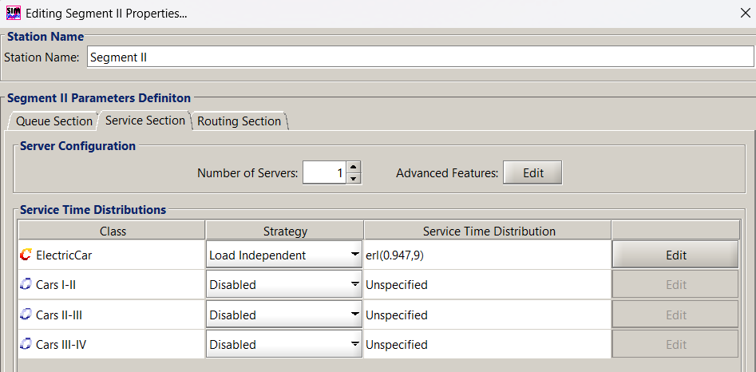
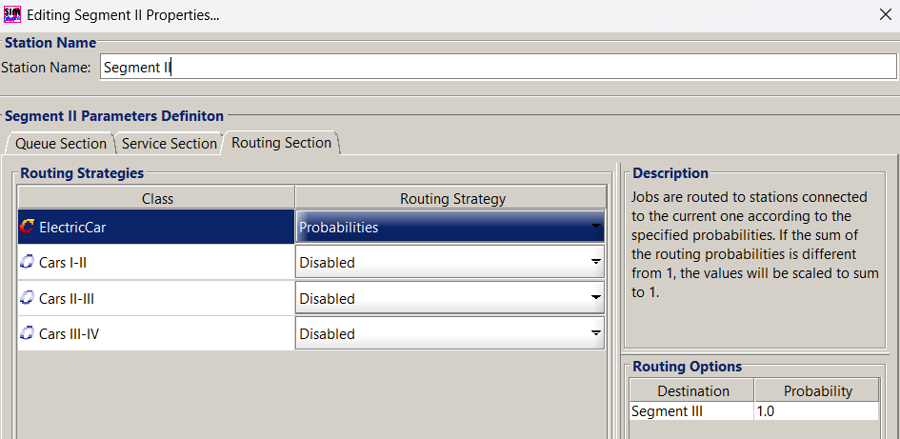
Project A - Recharging of an electric car on a highway
Segment II :
24
Angelo Maximilian Tulbure - 10931652

Slide 25
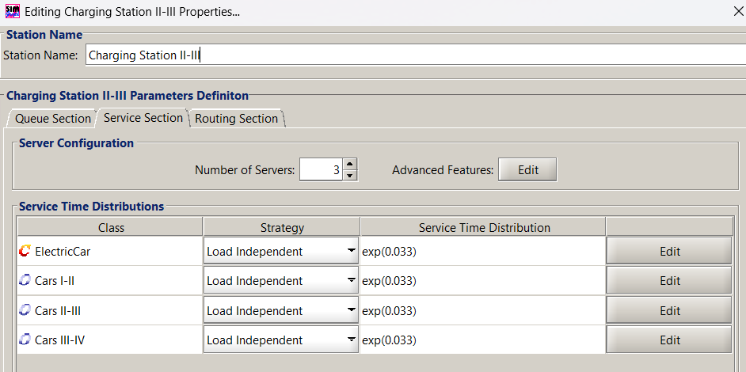
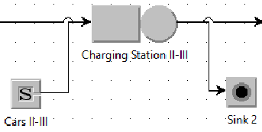
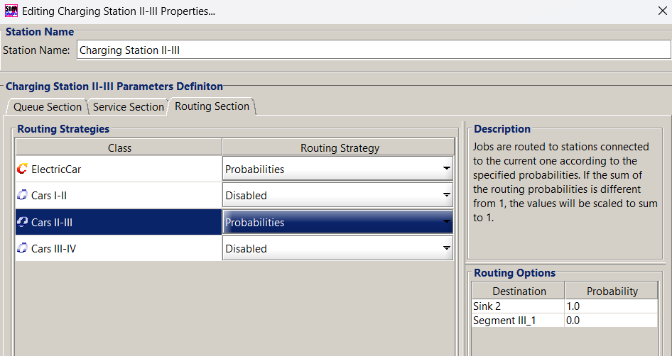
Project A - Recharging of an electric car on a highway
Charging Station II-III :
As there are 3 chargers in the station, I set the Number of Servers equal to 3.
Also in this case the traffic of the other cars, generated from a source, was directed entirely to a sink after the charging station (probability to go to the sink2 = 1).
25
Angelo Maximilian Tulbure - 10931652

Slide 26
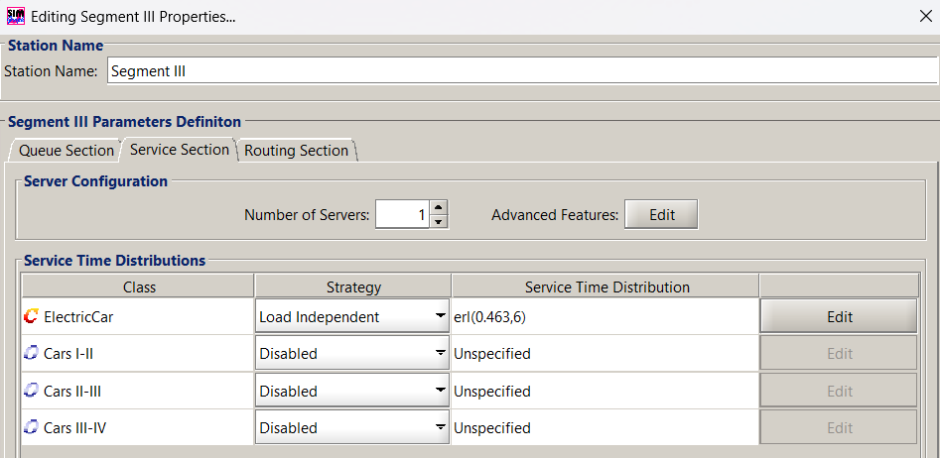
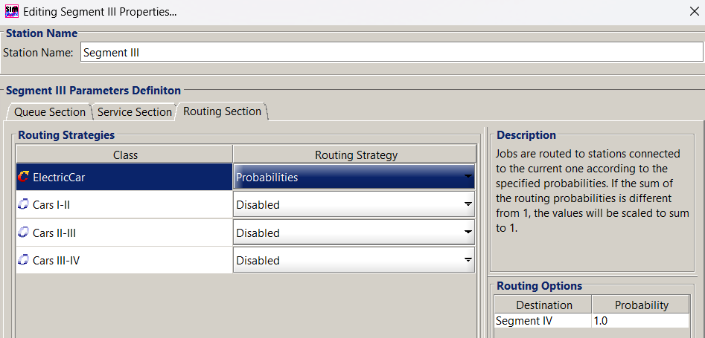
Project A - Recharging of an electric car on a highway
Segment III :
26
Angelo Maximilian Tulbure - 10931652

Slide 27
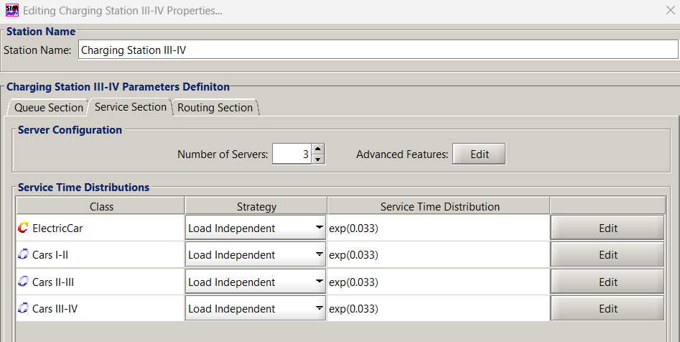
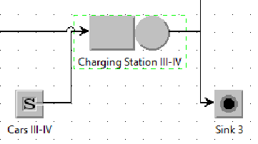
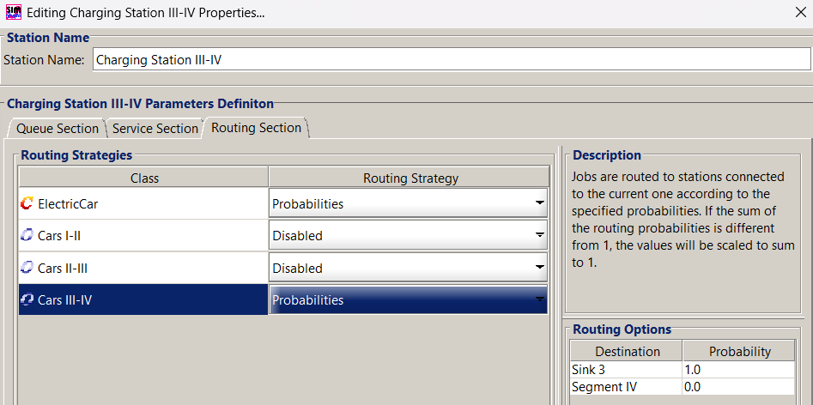
Project A - Recharging of an electric car on a highway
Charging Station III-IV :
As there are 3 chargers in the station I set the Number of Servers equal to 3.
Also in this case the traffic of the other cars, generated from a source, was directed entirely to a sink after the charging station (probability to go to the sink3 = 1).
27
Angelo Maximilian Tulbure - 10931652

Slide 28
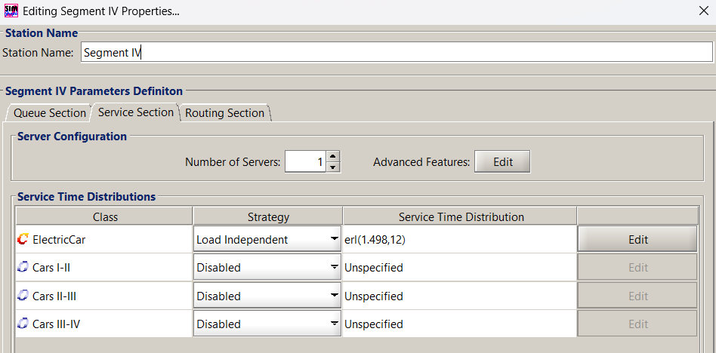
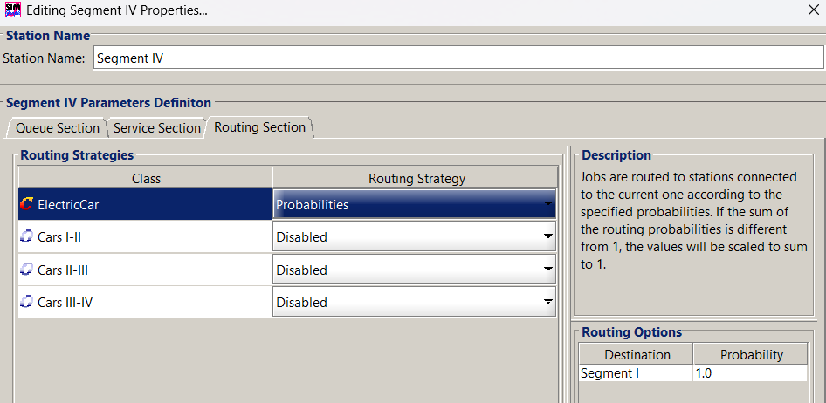
Project A - Recharging of an electric car on a highway
Segment IV :
I set the probability of the electric car, in the routing section of Segment IV, equal to 1 so the electric car is teleported back to the initial position to immediately start another trip.
28
Angelo Maximilian Tulbure - 10931652

Slide 29
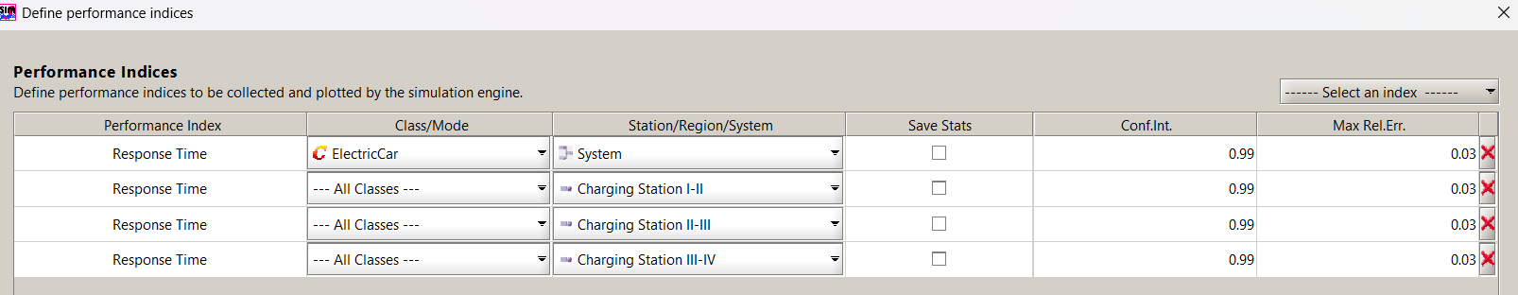
Project A - Recharging of an electric car on a highway
Performance indices collected and plotted by the simulation engine:
System Response Time for ElectricCar class
Charging Station I-II Response Time of All classes
Charging Station I-II Response Time of All classes
Charging Station I-II Response Time of All classes
29
Angelo Maximilian Tulbure - 10931652

Slide 30
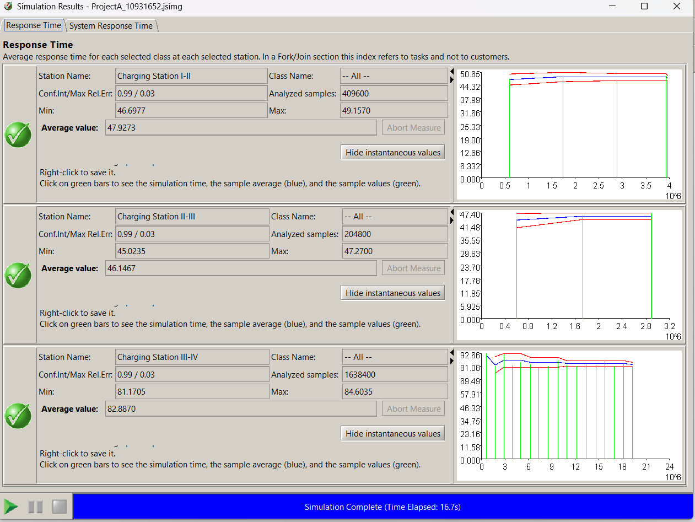
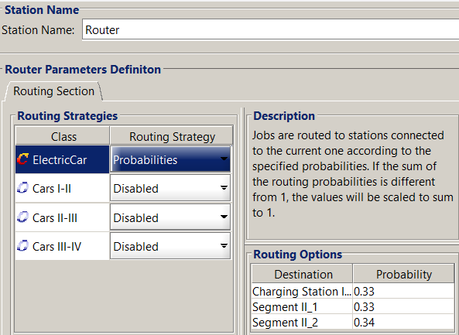
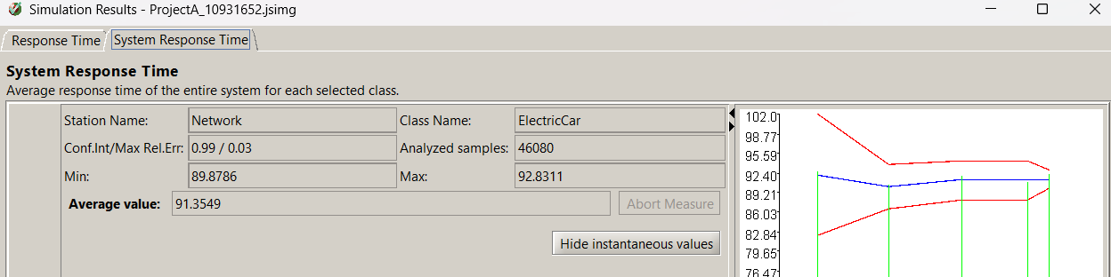
Project A - Recharging of an electric car on a highway
SIMULATION 1)
Simulation having routing probabilities:
prob(path 1) = 0,33
prob(path 2) = 0,33
prob(path 3) = 0,34
In this scenario we obtain an Average
Travelling Time of 91,3549 minutes.
30
Angelo Maximilian Tulbure - 10931652

Slide 31
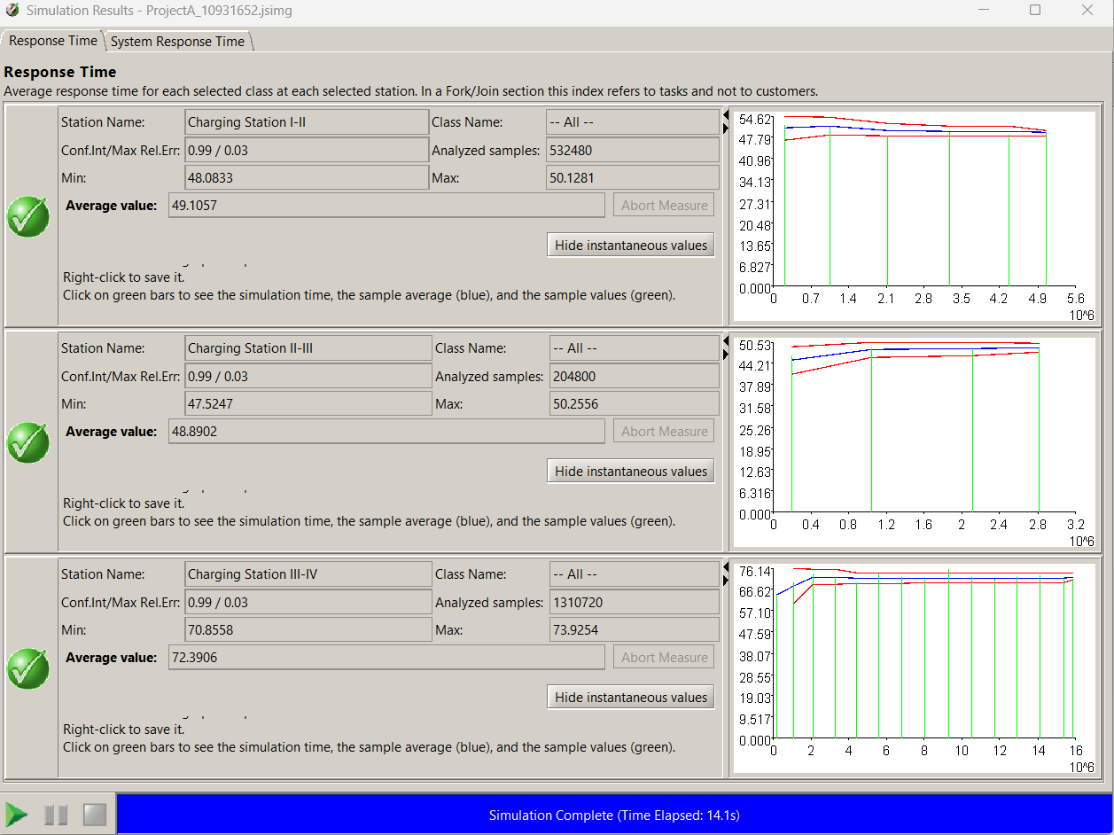
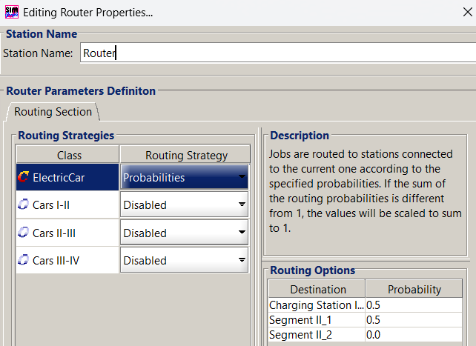
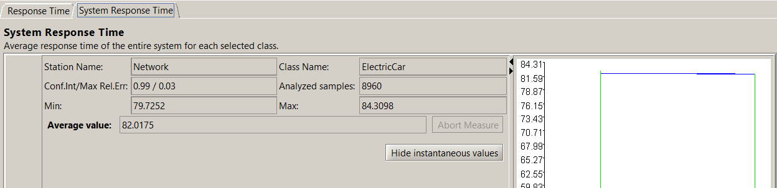
Project A - Recharging of an electric car on a highway
SIMULATION 2)
Simulation having routing probabilities:
prob(path 1) = 0,5
prob(path 2) = 0,5
prob(path 3) = 0
In this scenario we obtain an Average
Travelling Time of 82,0175 minutes.
31
Angelo Maximilian Tulbure - 10931652

Slide 32
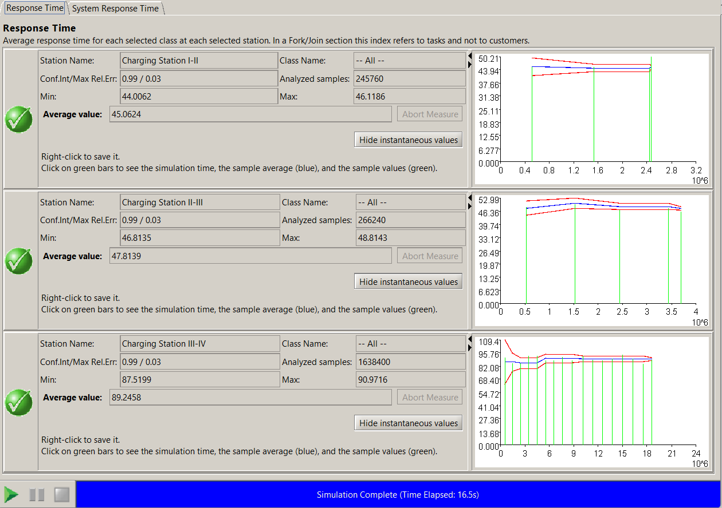
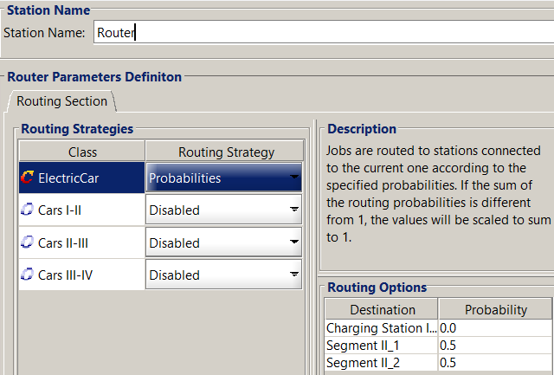
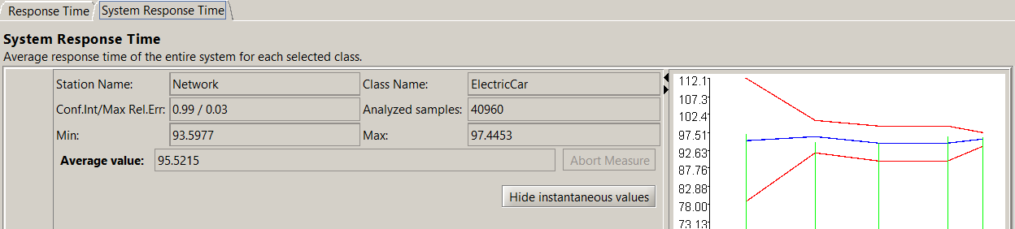
Project A - Recharging of an electric car on a highway
SIMULATION 3)
Simulation having routing probabilities:
prob(path 1) = 0
prob(path 2) = 0,5
prob(path 3) = 0,5
In this scenario we obtain an Average
Travelling Time of 95,5215 minutes.
32
Angelo Maximilian Tulbure - 10931652

Slide 33
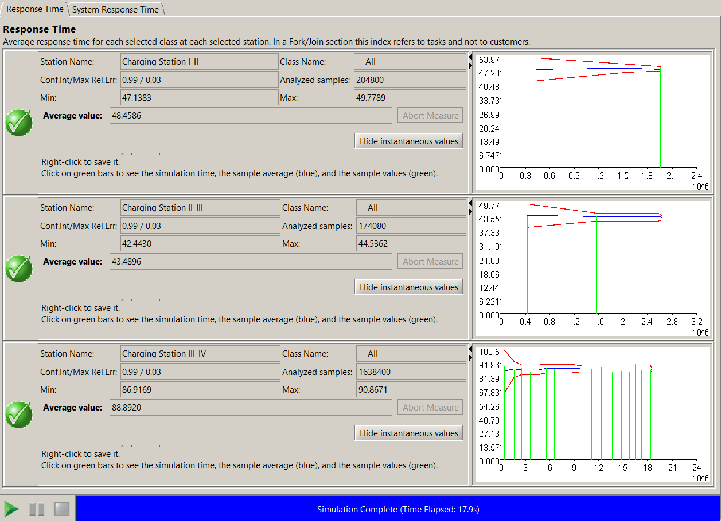
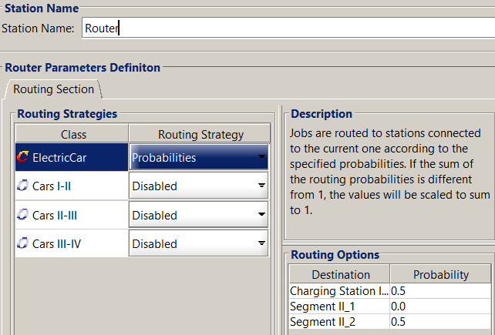
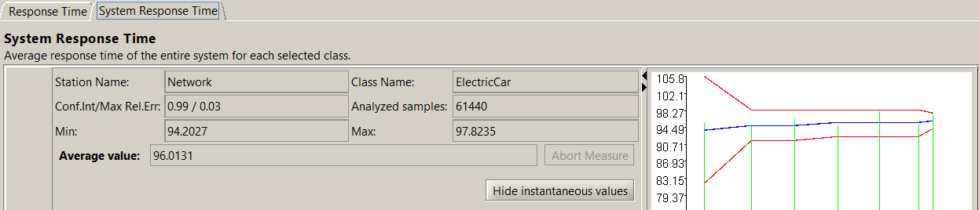
Project A - Recharging of an electric car on a highway
SIMULATION 4)
Simulation having routing probabilities:
prob(path 1) = 0,5
prob(path 2) = 0
prob(path 3) = 0,5
In this scenario we obtain an Average
Travelling Time of 96,0131 minutes.
33
Angelo Maximilian Tulbure - 10931652

Slide 34
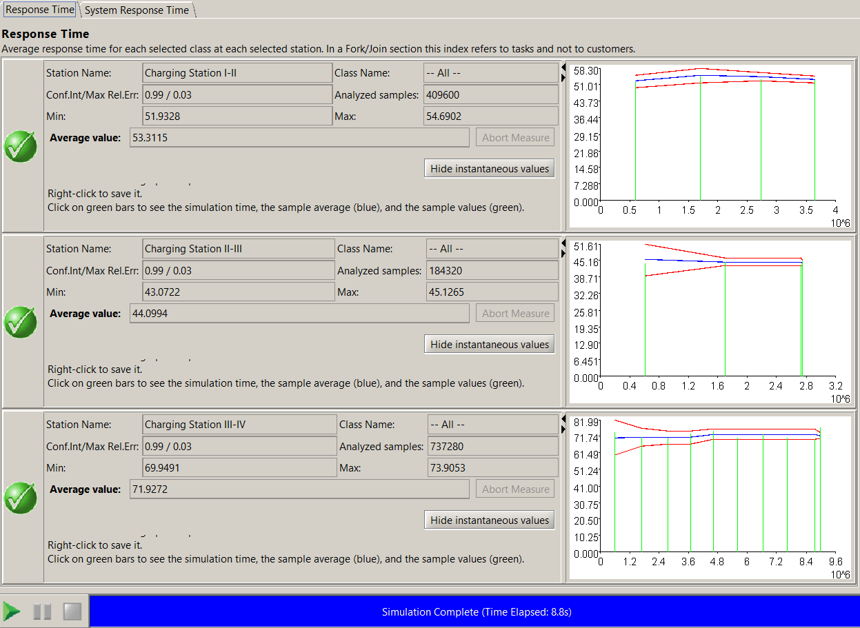
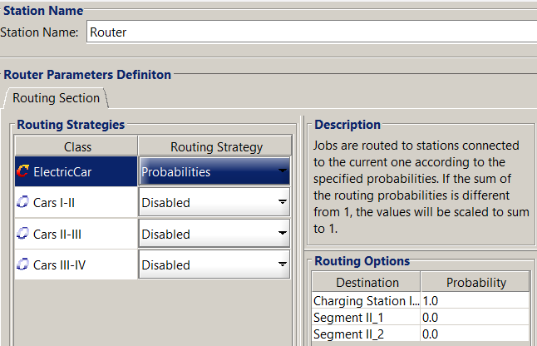
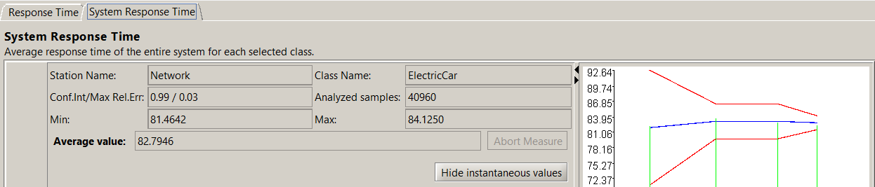
Project A - Recharging of an electric car on a highway
SIMULATION 5)
Simulation having routing probabilities:
prob(path 1) = 1
prob(path 2) = 0
prob(path 3) = 0
In this scenario we obtain an Average
Travelling Time of 82,7946 minutes.
34
Angelo Maximilian Tulbure - 10931652

Slide 35



Project A - Recharging of an electric car on a highway
SIMULATION 6)
Simulation having routing probabilities:
prob(path 1) = 0
prob(path 2) = 1
prob(path 3) = 0
In this scenario we obtain an average
Travelling time of 81,2512 minutes.
35
Angelo Maximilian Tulbure - 10931652

Slide 36



Project A - Recharging of an electric car on a highway
SIMULATION 7)
Simulation having routing probabilities:
prob(path 1) = 0
prob(path 2) = 0
prob(path 3) = 1
In this scenario we obtain an average
travelling time of 110,9884 minutes
36
Angelo Maximilian Tulbure - 10931652

Slide 37
Project A - Recharging of an electric car on a highway
The best stopping probability distribution, between the 7 different scenario tested is:
prob(path 1) = 0
prob(path 2) = 1
prob(path 3) = 0
So the best stopping probably is to stop at Charging Station II-III with prob = 1.
With these stopping probabilities, the average travelling time is 81,2512 minutes (1 hour and 35 minutes) and its confidential interval is [min: 80,1111, max:82,3914].
37
Angelo Maximilian Tulbure - 10931652

